Slide 1

Design & Analysis of Algorithm
CS-503
Computer Science
Lecture 2
Asymptotic notation
BY: Bushra Saif

Slide 2
WHY
Does the algorithm suddenly become incredibly slow when the input size grows?
Does it mostly maintain its quick run time as the input size increases?
Asymptotic Notation gives us the ability to answer these questions.
L1.<number>

Slide 3
Asymptotic Notation
An algorithm may not have the same performance for different types of inputs. With the increase in the input size, the performance will change.
The study of change in performance of the algorithm with the change in the order of the input size is defined as asymptotic analysis.
“Asymptotic Notation is used to describe the running time of an algorithm - how much time an algorithm takes with a given input, n. This is also known as an algorithm’s growth rate“
L1.<number>

Slide 4
Asymptotic Notation
Does the algorithm suddenly become incredibly slow when the input size grows?
Does it mostly maintain its quick run time as the input size increases?
Asymptotic Notation gives us the ability to answer these questions.
Running time of an algorithm as a function of input size n for large n.
Expressed using only the highest-order term in the expression for the exact running time.
Instead of exact running time, say O(n2).
Describes behavior of function in the limit.
Written using Asymptotic Notation.
L1.<number>

Slide 5
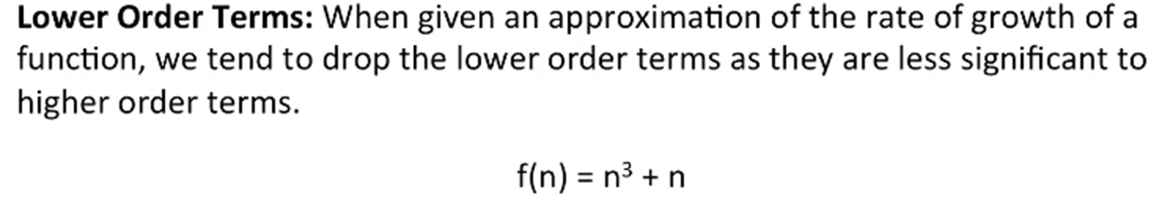


Asymptotic Notation
When an algorithm consists of many parts, we describe its runtime based on the slowest part of the program.
Example: An algorithm with three parts has running times of Θ(2N) + Θ(log N) + Θ(1). We only care about the slowest part, so we would quantify the runtime to be Θ(N). We would also drop the coefficient of 2 since when N gets really large, the multiplier 2 will have a small effect.
L1.<number>

Slide 6
Types of Analysis
There are three different notations: big O, big Theta (Θ), and big Omega (Ω).
big-Θ (theta) or Average case is used when the running time is the same for all cases (average time)
big-O or for the worst case running time (longest time)
big-Ω (omega) for the best case running time (least time)
L1.<number>

Slide 7
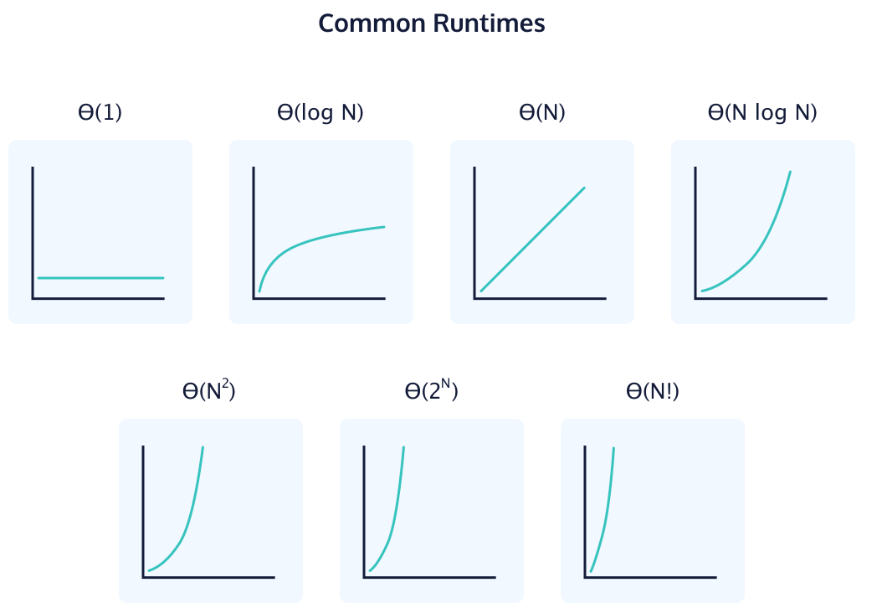
The common algorithmic runtimes from fastest to slowest are:
L1.<number>

Slide 8
Time Complexity Analysis
Worst case: For 'n' input size, the worst-case time complexity can be defined as the maximum amount of time needed by an algorithm to complete its execution.
Average case: For 'n' input size, the average-case time complexity can be defined as the average amount of time needed by an algorithm to complete its execution.
Best case: For 'n' input size, the best-case time complexity can be defined as the minimum amount of time needed by an algorithm to complete its execution.
Thus, it is nothing but a function defined by the max./average/min. number of steps performed on an instance having an input size of n.
L1.<number>

Slide 9
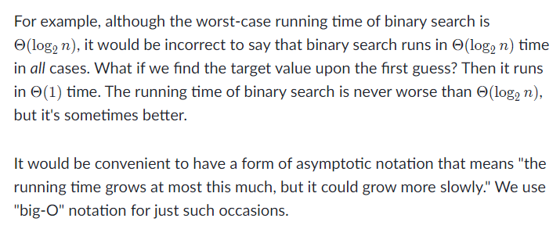
Big O
L1.<number>

Slide 10
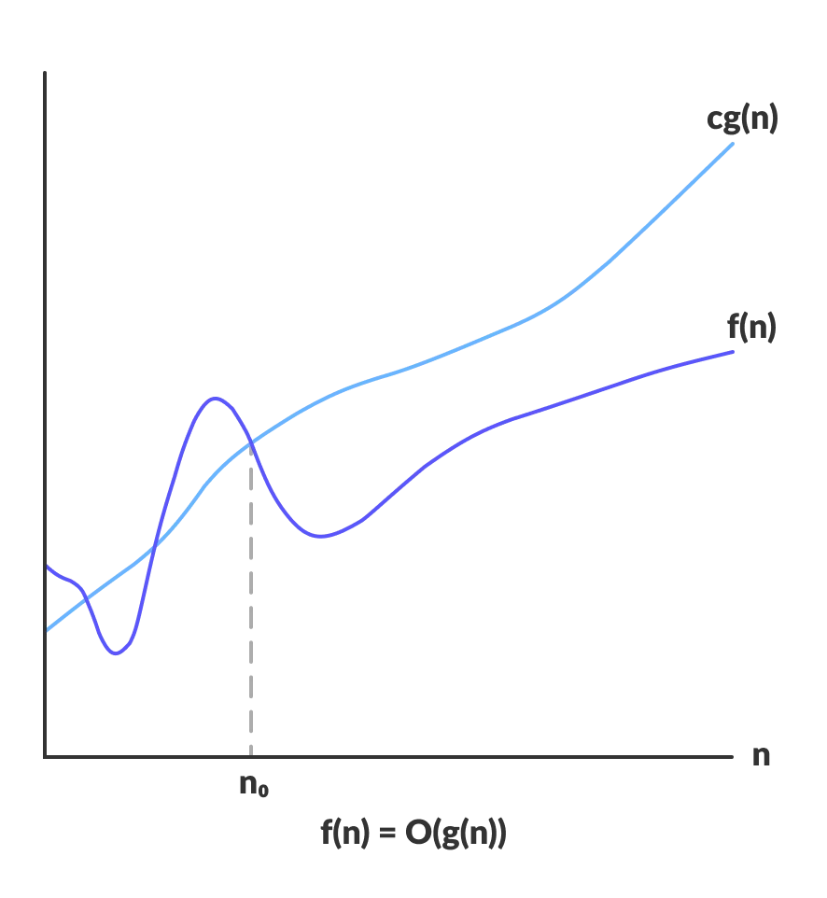
Big O mathematical term
Upper bound
Function f(n) depicting the behavior of an algorithm with respective to input size n.
f(n) <= cg(n)
n >= n₀
c >0
n₀ >= 1
f(n) = O(g(n))
For any value of n, the running time of an algorithm does not cross the time provided by O(g(n)).
L1.<number>

Slide 11
Big Ω
Omega notation represents the lower bound of the running time of an algorithm. Thus, it provides the best case complexity of an algorithm.
Sometimes, we want to say that an algorithm takes at least a certain amount of time, without providing an upper bound. We use big-Ω notation; that's the Greek letter "omega."
L1.<number>

Slide 12
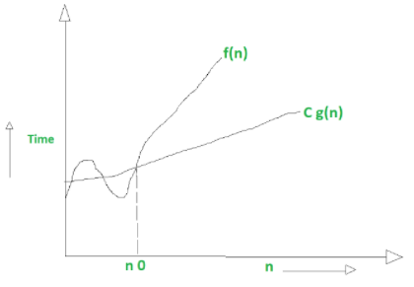
Big Ω mathematical term
Lower bound
Function f(n) depicting the behavior of an algorithm with respective to input size n.
f(n) >= cg(n)
n >= n₀
c >0
n₀ >= 1
f(n) = Ω (g(n))
L1.<number>

Slide 13
Big Θ
Theta notation encloses the function from above and below. Since it represents the upper and the lower bound of the running time of an algorithm, it is used for analyzing the average-case complexity of an algorithm.
L1.<number>

Slide 14
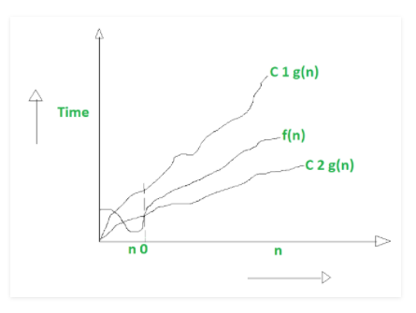
Big Θ mathematical term
asymptotically tight bound
Function f(n) depicting the behavior of an algorithm with respective to input size n.
C₂ g(n)<=f(n)<=C₁ g(n)
n >= n₀
c >0
n₀ >= 1
f(n) = Θ (g(n))
L1.<number>

Slide 15



Comparison
L1.<number>

Slide 16
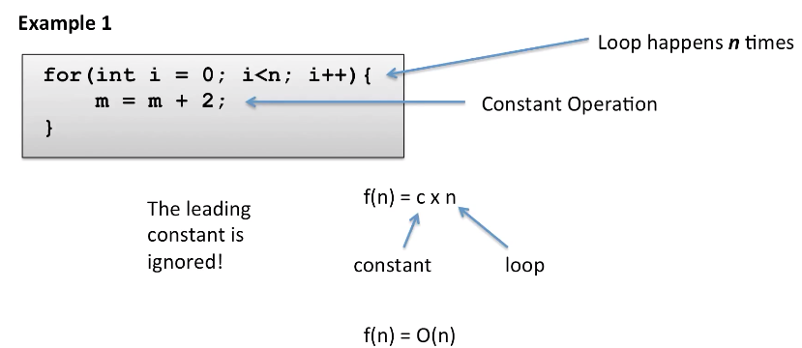
Big O

Slide 17
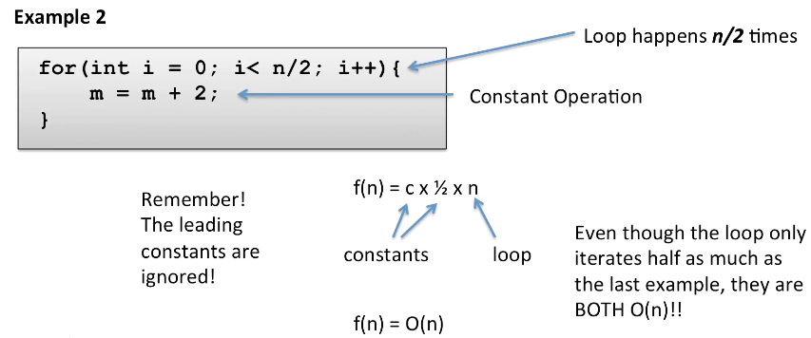

Slide 18
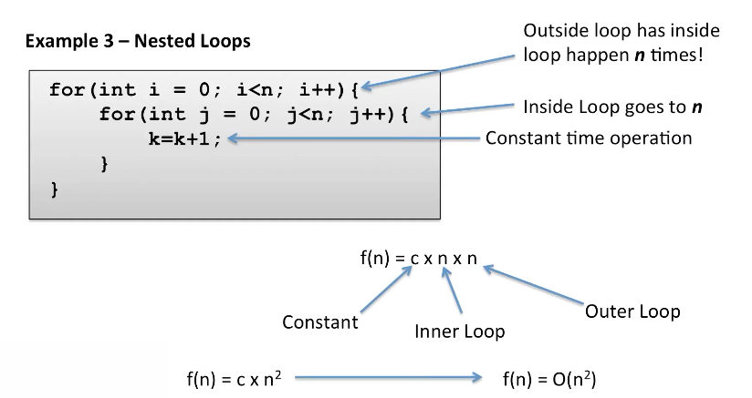

Slide 19
